Slide 1
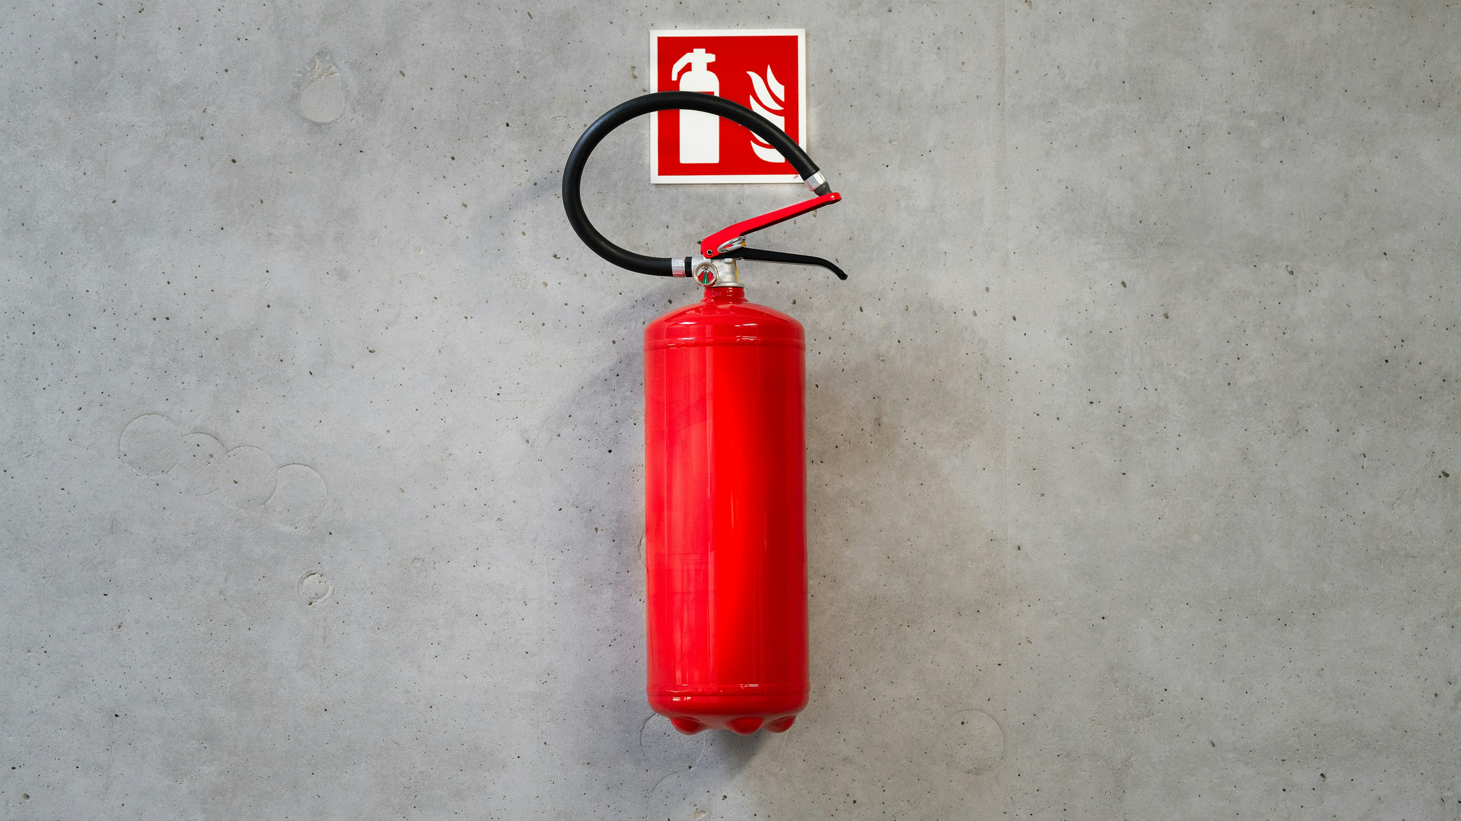

Incident Analysis Report Analyzing Fire and Rescue Service Incident across the United kingdom
Toluwase Idowu

Slide 2
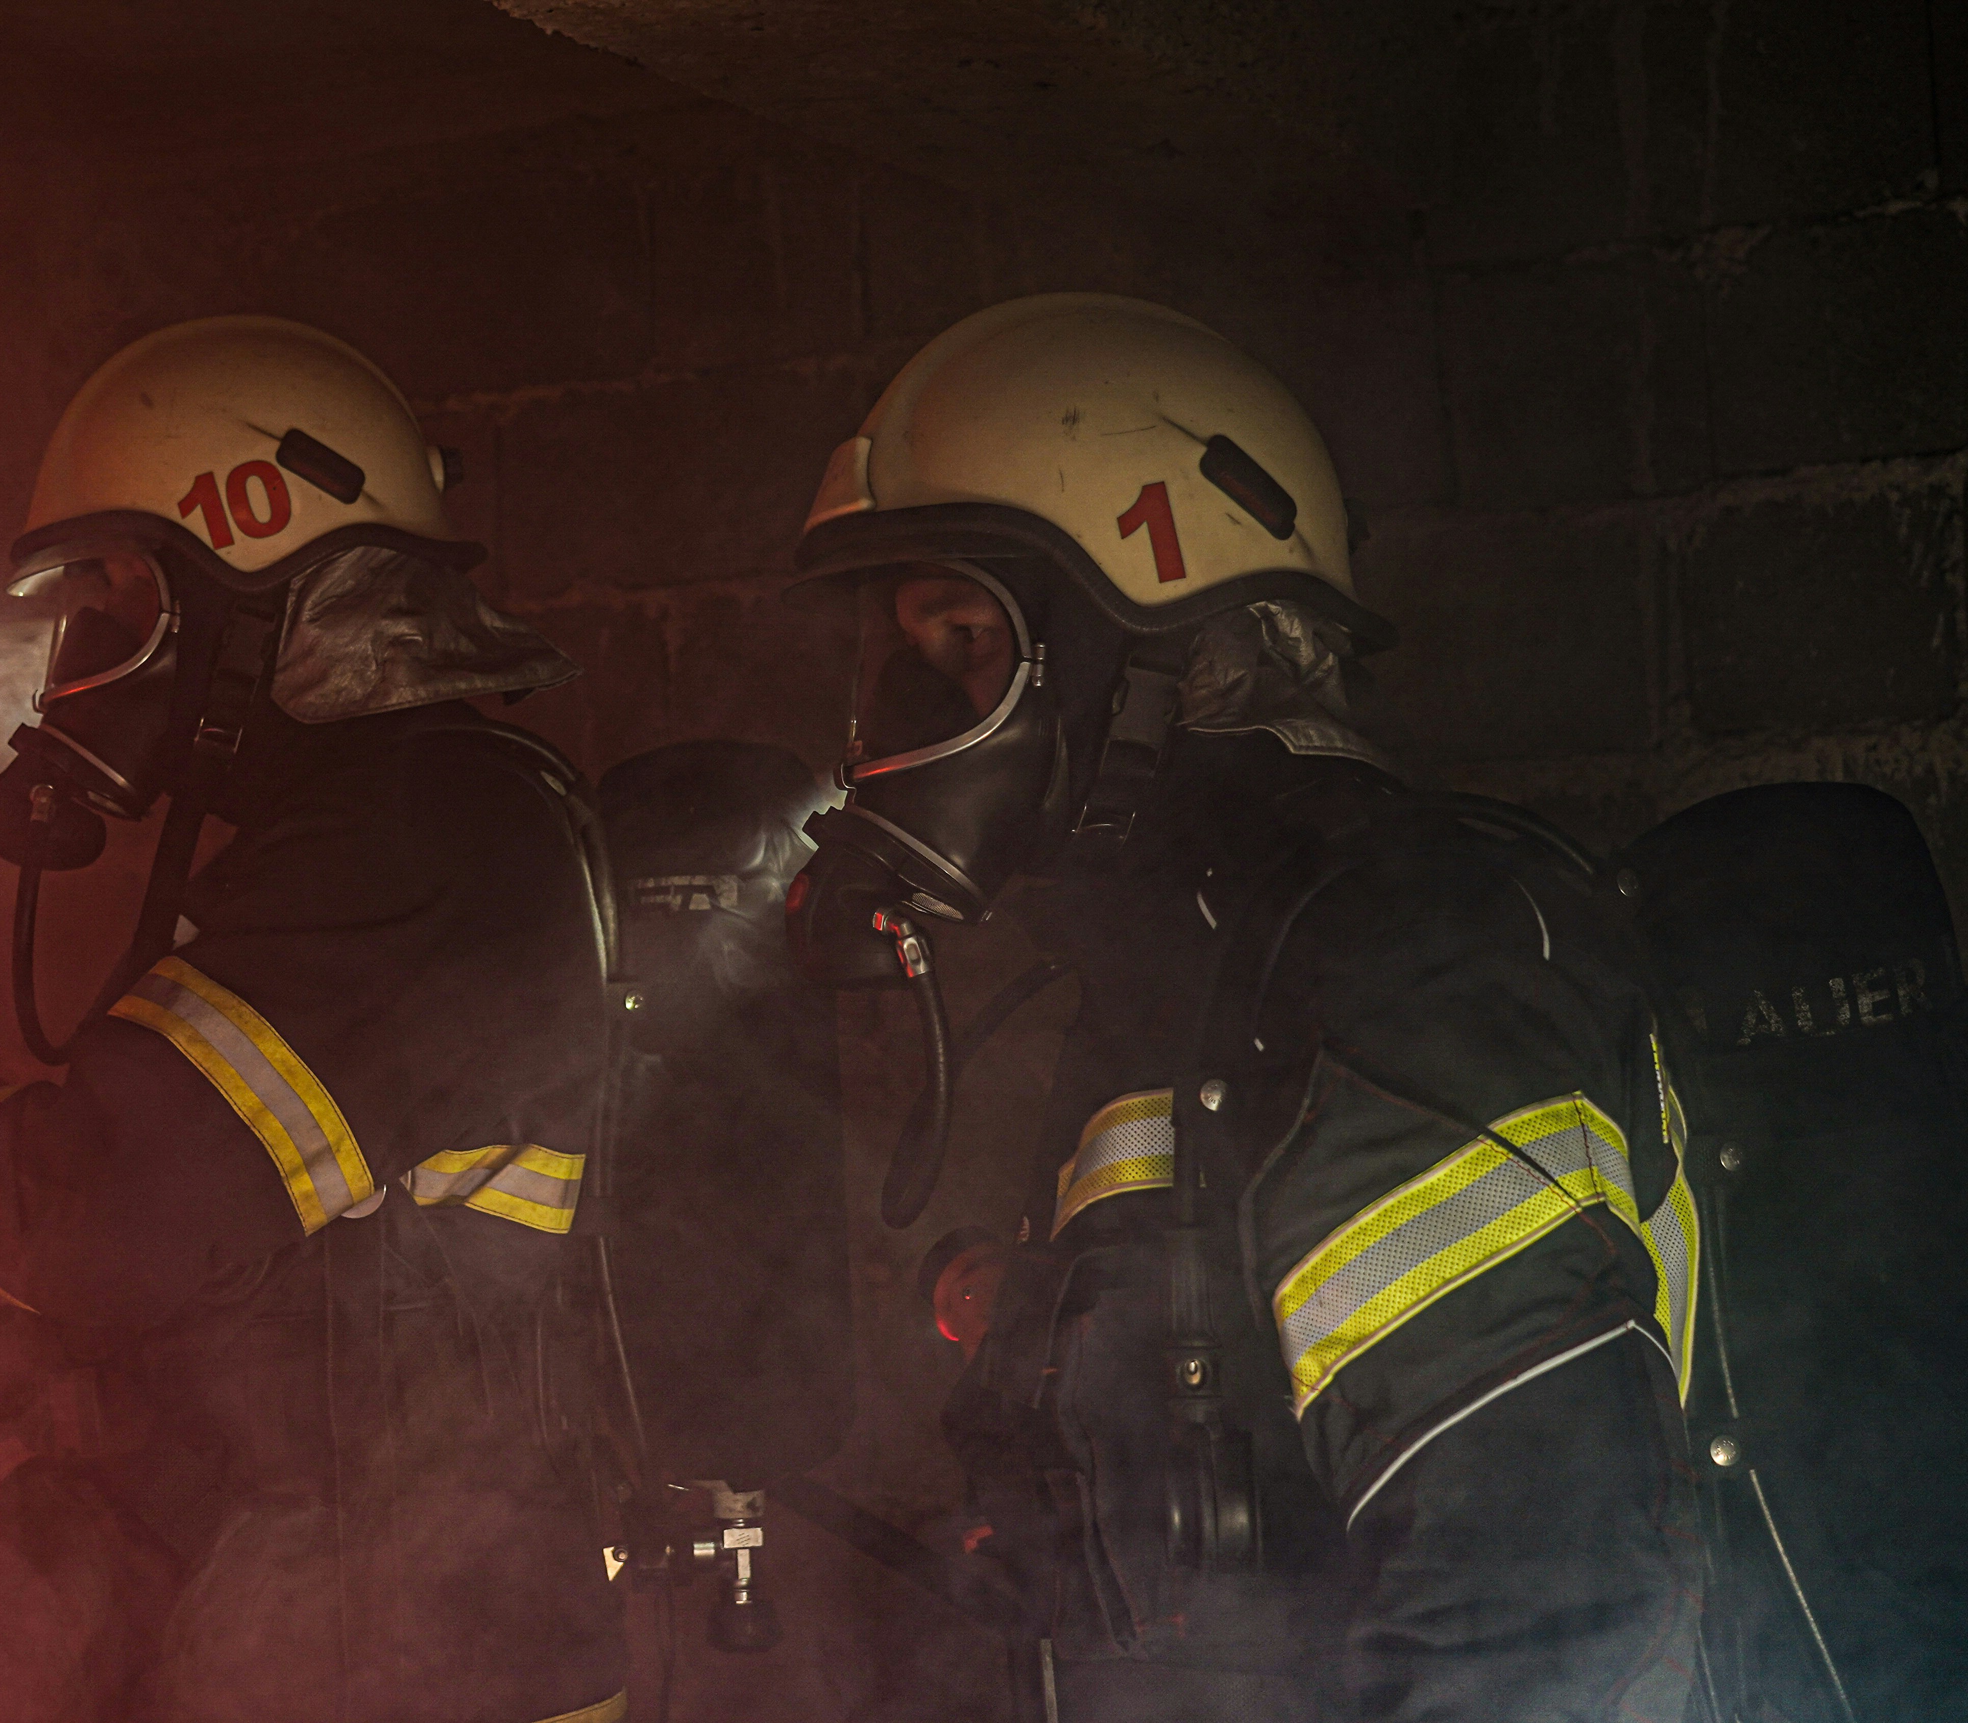
Introduction
This analysis aims to provide insights into the incidents handled by various Fire and Rescue Services (FRS) across the UK, with a specific focus on comparing these incidents to those handled by the Hampshire & Isle of Wight FRS. By understanding the distribution and trends of incidents, this analysis supports strategic planning and resource allocation. The dataset spans from the first quarter of 2010/11 to the third quarter of 2023/24 and includes details such as incident type, FRS name, and the total number of incidents.

Slide 3
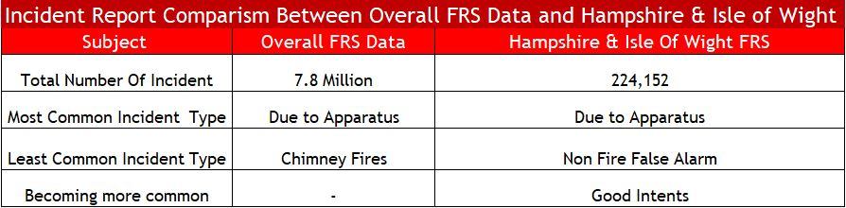
This table compares incident data between the overall Fire and Rescue Services (FRS) in the UK and the Hampshire & Isle of Wight FRS. The overall FRS reported 7.8 million incidents, with "Due to Apparatus" being the most common incident type, while Hampshire & Isle of Wight FRS reported 224,152 incidents, also with "Due to Apparatus" as the most common. For Hampshire & Isle of Wight FRS, "Good Intents" incidents are becoming more common, and "Non-Fire False Alarms" are the least common incident type.

Slide 4
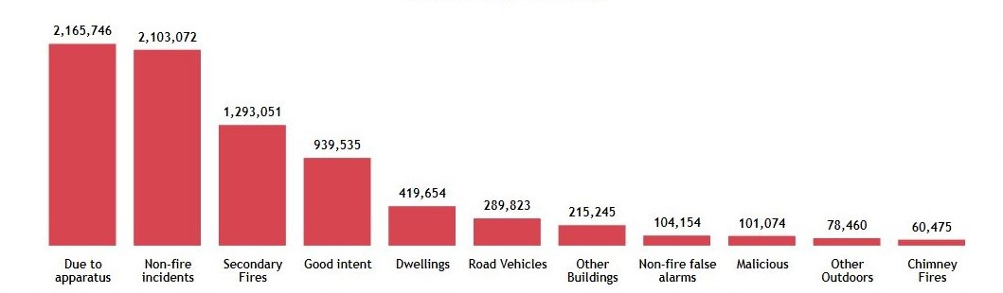
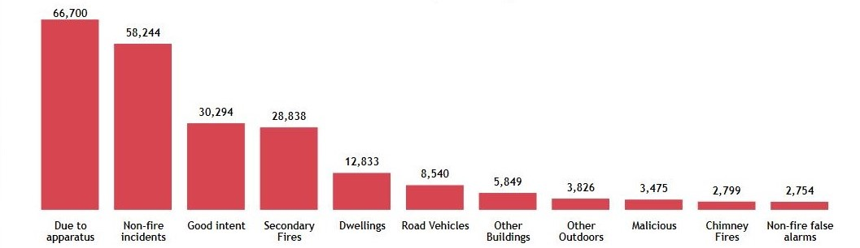
Comparison By Incident Type
Overall Fire and Rescue Services (FRS) in the UK
Hampshire & Isle of Wight FRS

Slide 5
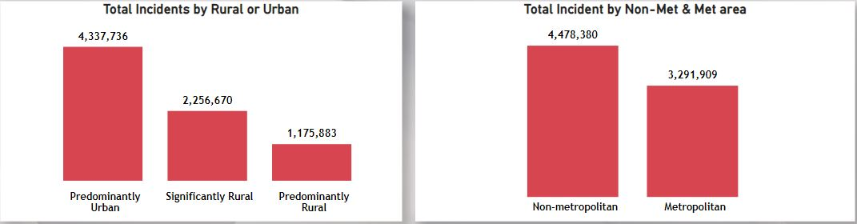
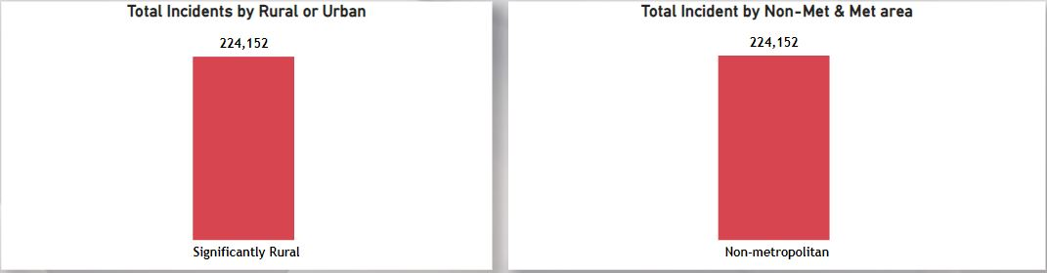
Hampshire and Isle of Wight vs Other Regions
Overall Fire and Rescue Services (FRS) in the UK
Hampshire & Isle of Wight FRS

Slide 6
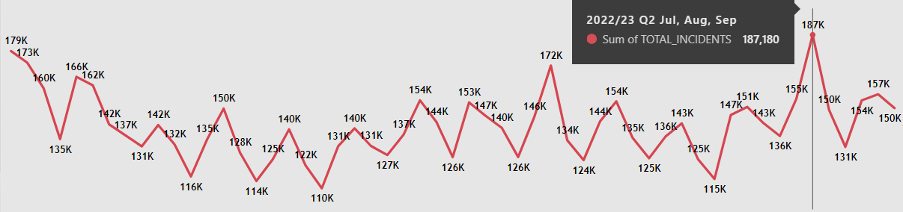
Total incident by Quarter
The number of incidents per quarter fluctuated throughout the series, with the highest number recorded in 2022/23 Q2 (Jul, Aug, Sep) at 187,180 incidents, and the lowest in 2014/15 Q4 (Jan, Feb, Mar) at 110,137 incidents.

Slide 7
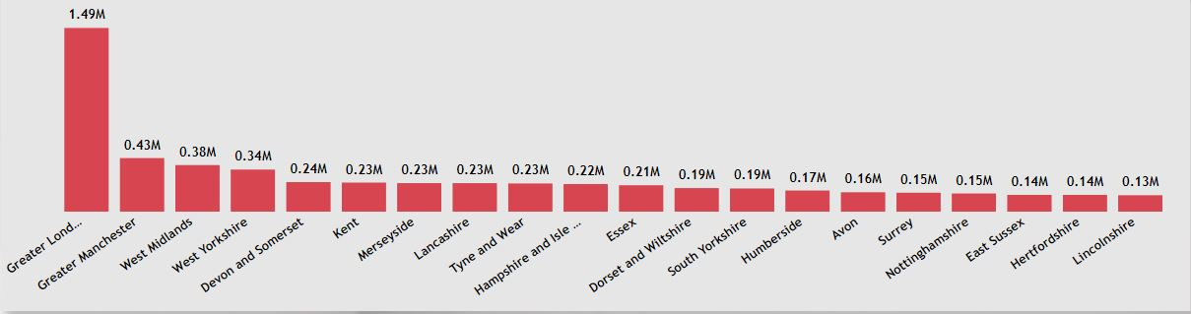
Hampshire and Isle of Wight vs Incident Distribution Across the UK
The bar chart illustrates the total number of incidents handled by each Fire and Rescue Service. Among the incidents recorded, Greater London had the highest number with 1,493,910 incidents. Hampshire and Isle of Wight reported 224,152 incidents, placing them in the mid-range compared to other regions. Lincolnshire recorded the lowest number of incidents with 131,661. This comparison helps contextualize the incident volume in Hampshire and Isle of Wight relative to other regions.

Slide 8
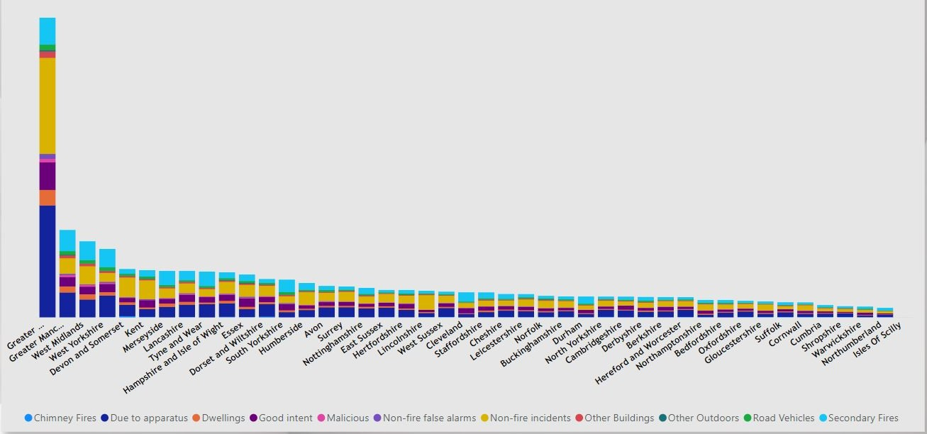
Incidents Types by FRS Name

Slide 9
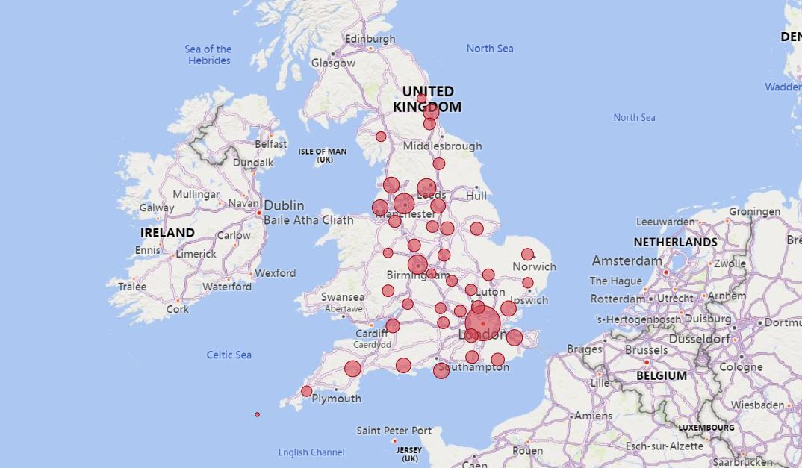
Geospatial Analysis - Incident Distribution Across the UK
Map showing the geographic distribution of incidents

Slide 10
Recommendations
Allocate more resources to RURAL areas within Hampshire and Isle of Wight
Enhance preventive measures for common incident types in these regions
Strategically plan for areas with high population density to improve response times
Enhance Preventive Measures for Common Incident Types
Increase Community Engagement and Education
Implement Advanced Technology and Data Analytics
Expand Training Programs for First Responders
Strengthen Infrastructure and Equipment

Slide 11

Proposal
Further analysis is needed to incorporate population data. The table in the brief contained population for 36 FRS, while the analysis requires data for 44 stations. Therefore, this aspect could not be addressed in the current version of the work.

Slide 12

Questions

